Slide 1
OGC and GeoBIM
Standardizing digital twins, exercising integration in the real world
30 October 2024 | Scott Simmons, OGC

Slide 4
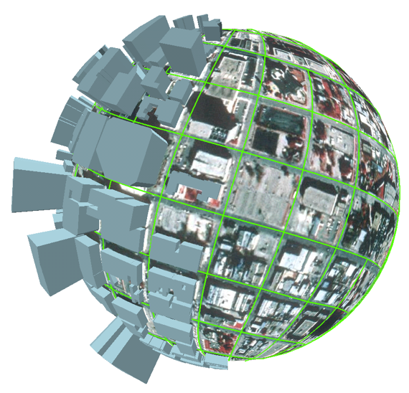
OGC vision in 2012
GIS
BIM
Infra

Slide 5
Digital Twins

Slide 6
Connecting underground, land, sea, sky, space
DALL-E: draw a cartoon schematic of a harbor including underground, buildings, airplane, and satellite

Slide 7
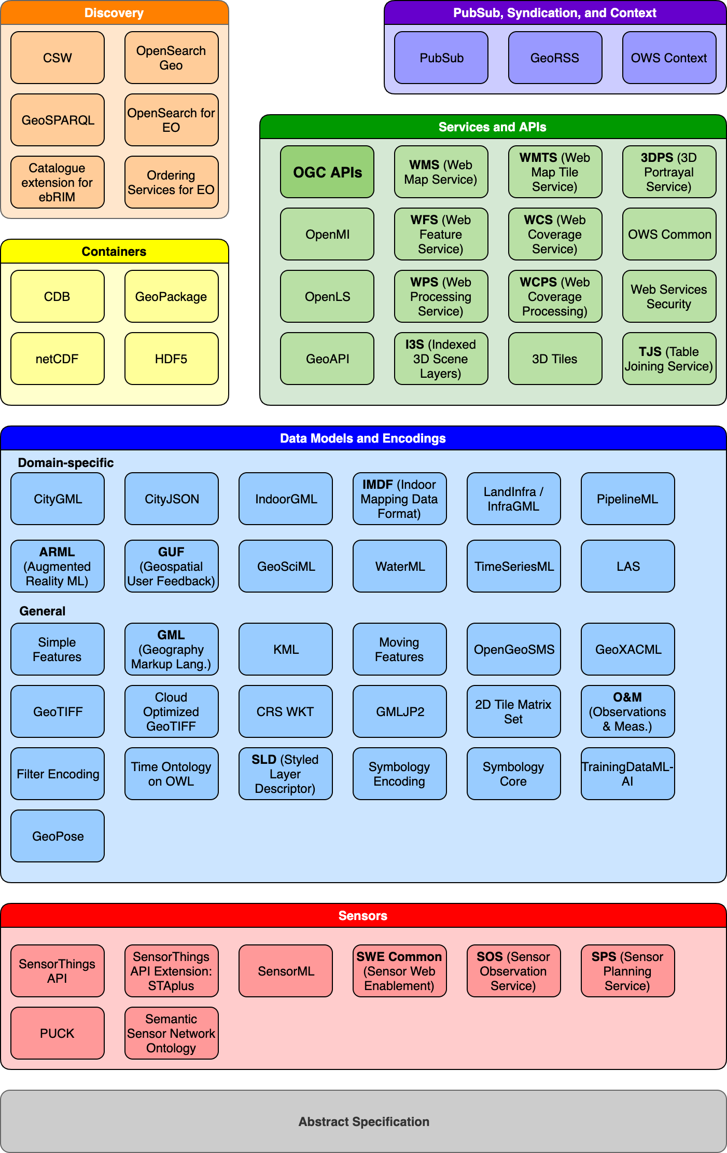
“The nice thing about standards is that you have so many to choose from…”
Andrew Tanenbaum

Slide 8
Discrete functions represented by individual Standards linked to form solutions

Slide 9
KML
Geometry: 2D + extrude
Can insert 3D models, such as COLLADA files
Levels of Detail (LOD) for datasets
Portray statistical data
Limited to KML Coordinate Reference System (adapted from WGS84)

Slide 10
GML encoding
data model
3 encodings
OGC Community Standard
3D City DB

Slide 11
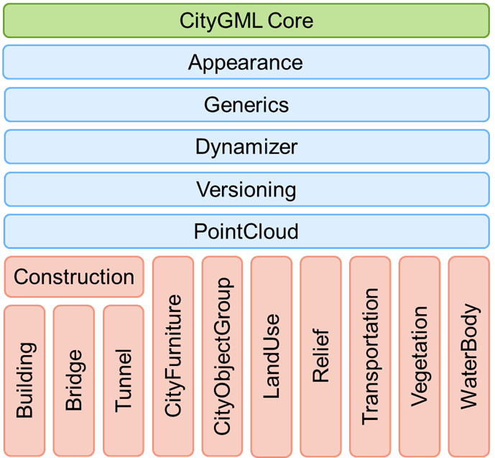
CityGML 3.0 Module Overview
Revised
Defines base concepts and geometries inherited by all other modules
Revised
New
Defines concepts applicable to all thematic modules
New
New
New
Thematic modules
Revised
Revised

Slide 12
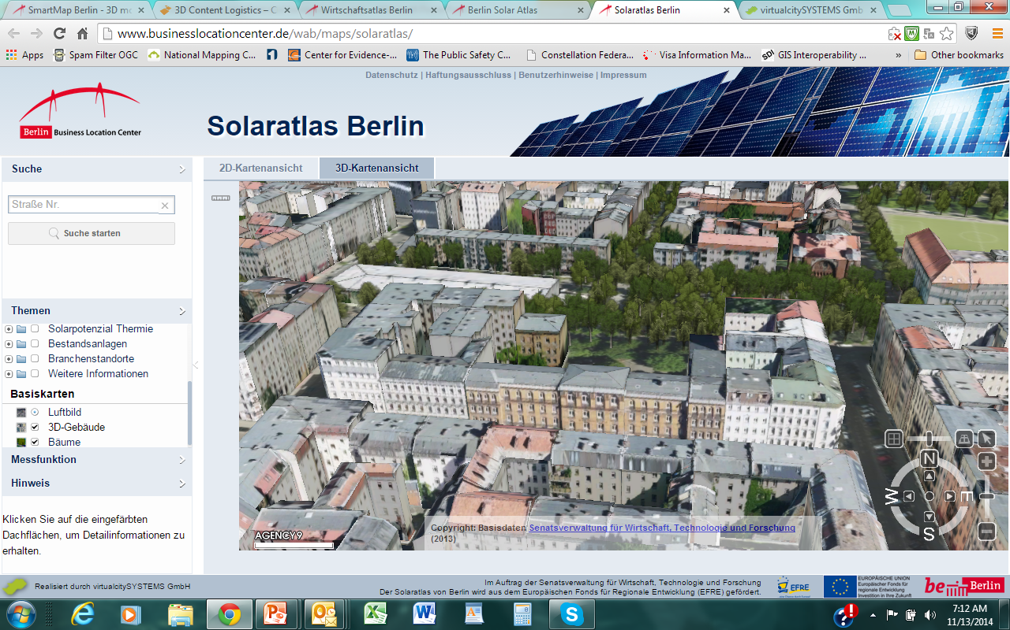
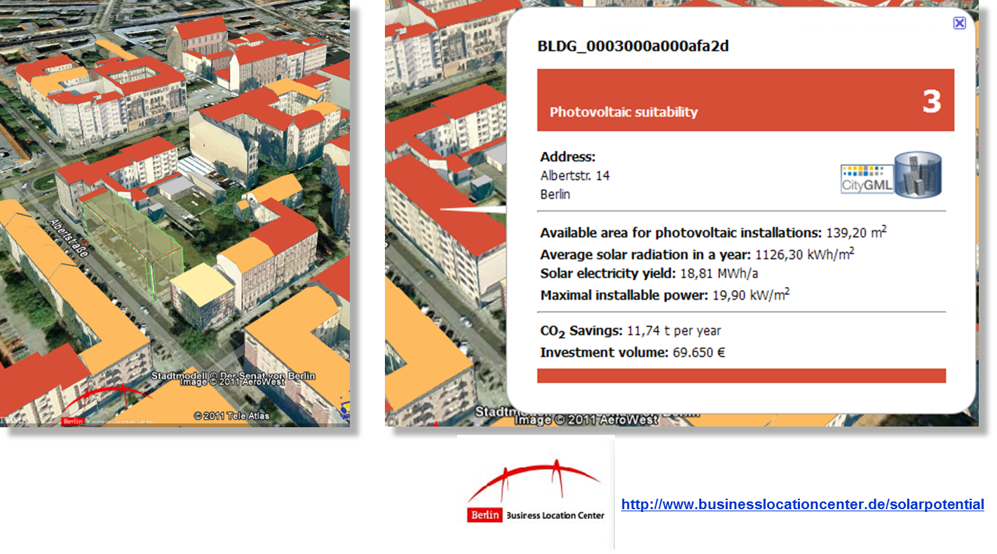
OGC CityGML Standard: Solar Energy Production Potential Analysis
Solar power potential and CO2 offset potential computed for the 550,000 buildings in the Berlin 3D city model.

Slide 13
Singapore 3D City Model
Built upon the existing survey infrastructure and mapping expertise in SLA. Four major phases:
Capture 3D Data – airborne and land-based Photogrammetry and Laser Scanning (LiDAR- Light Detection and Ranging) survey
Create 3D Data Models – CityGML exchange format
Establish Standards and Database – CityGML Schema
Update Changes
In order to support “smart” 3D applications, the 3D models are created and stored in an international open standard with intelligent data model known as the CityGML format.
Mr. Tan Boon Khai (center), Chief Executive, Singapore Land Authority receiving the Geospatial World Excellence award
https://www.geospatialworld.net/news-posts/3d-mapping-singapore-geospatial-award/

Slide 14
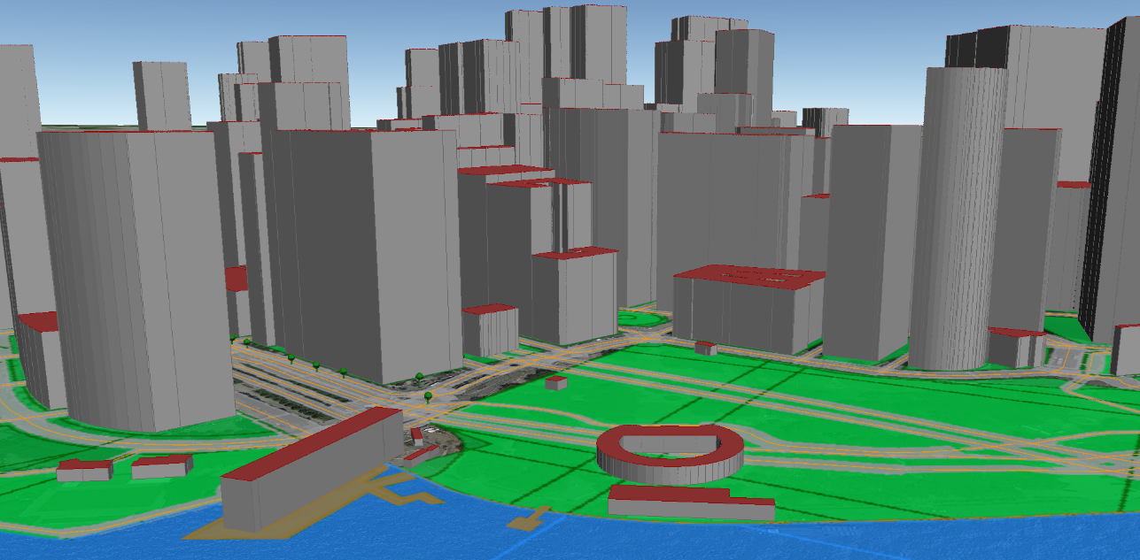
New York City 3D Model Built from Available Open NYC Data
> 1,000,000 buildings
> 866,000 land lots
> 149,000 streets
> 16,000 parks
> 9,500 water bodies
> DTM with 1m resolution
fully-automatically generated from the 2D geodata published in the NYC Open Data Portal
semantic and geometric transformations
all objects have 3D geometry
rich semantic information (5 - 75 attributes per object resulting from combining different NYC datasets)
integrated within 1 dataset!
The 3D CityGML model is Open Data! Download: www.gis.bgu.tum.de/en/projects/new-york-city-3d/

Slide 15
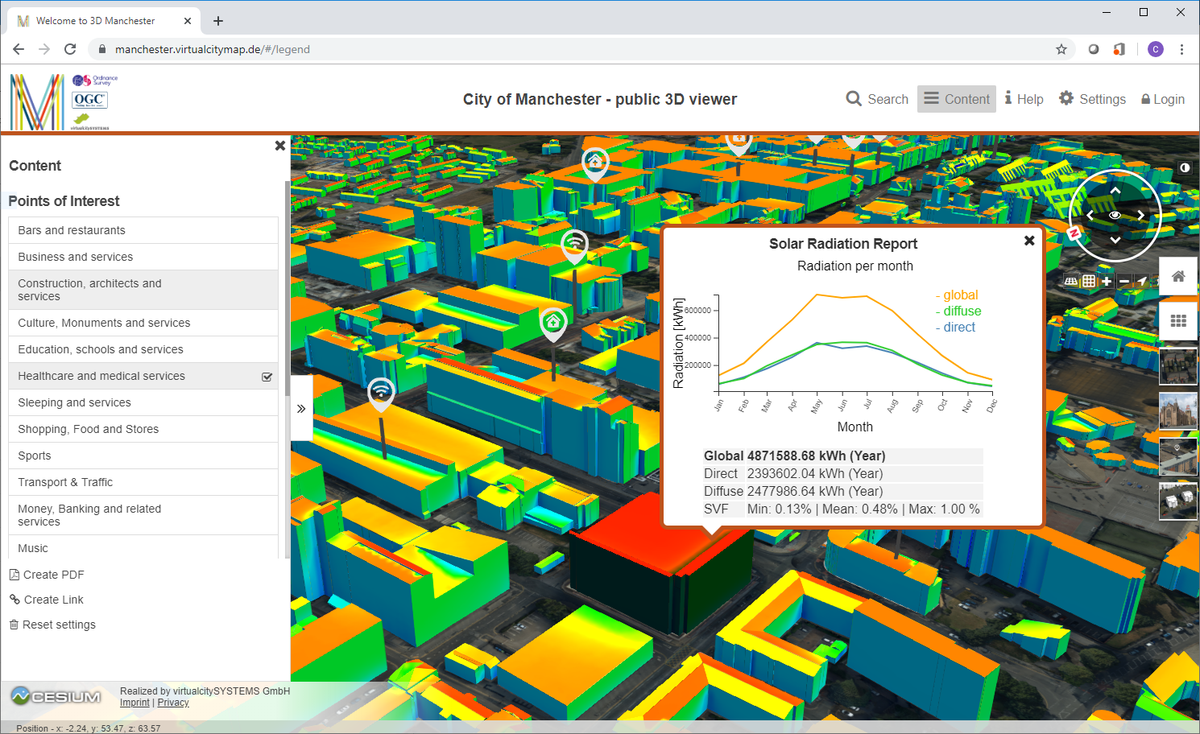
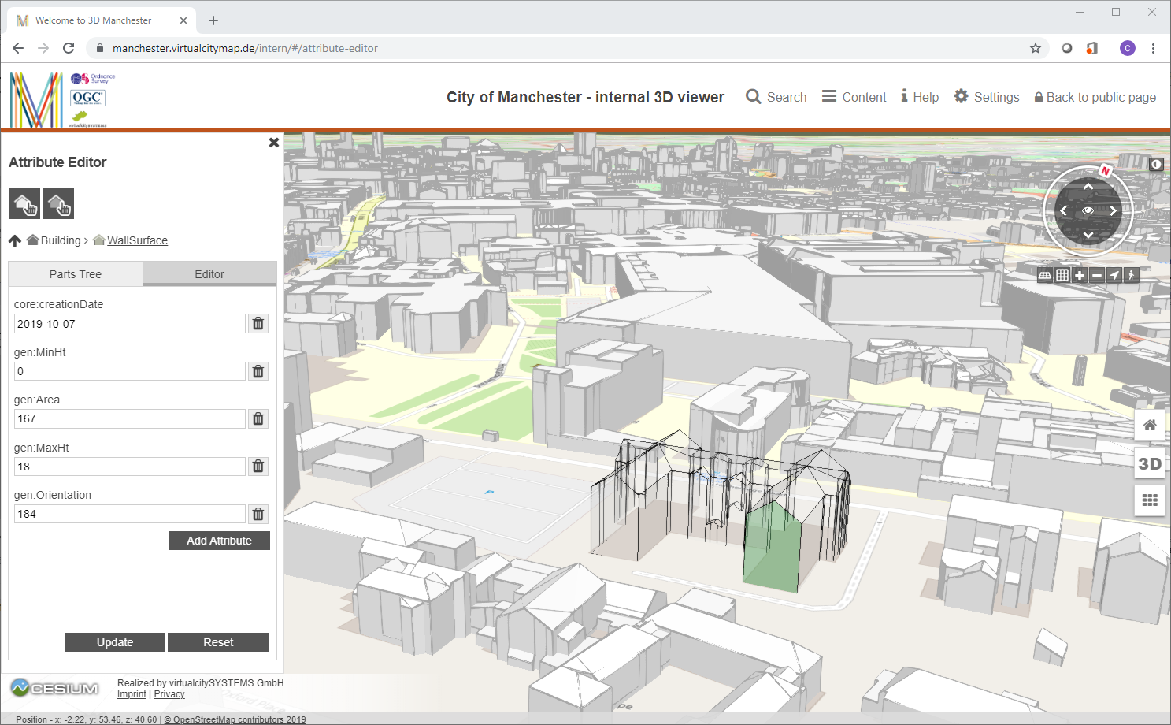
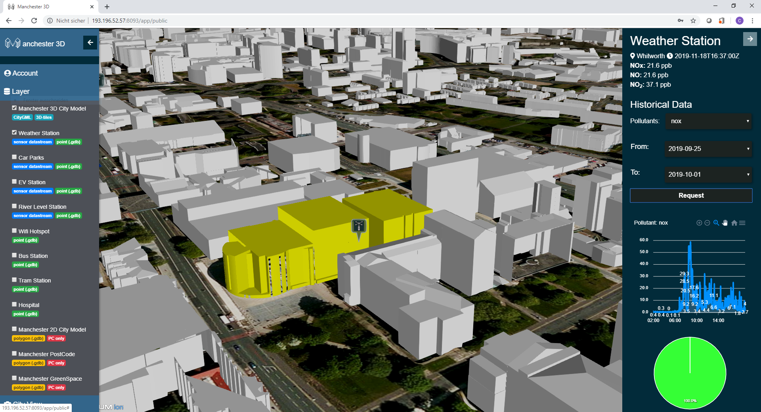
OGC CityGML 3.0 Challenge

Slide 16
CityJSON
Initiated by 3D geoinformation group at TU Delft, Netherlands
CityJSON 1.0 encoding of a subset of CityGML 2.0
CityJSON 2.0 encoding of a subset of CityGML 3.0
OGC Community Standard
cityjson.org

Slide 17
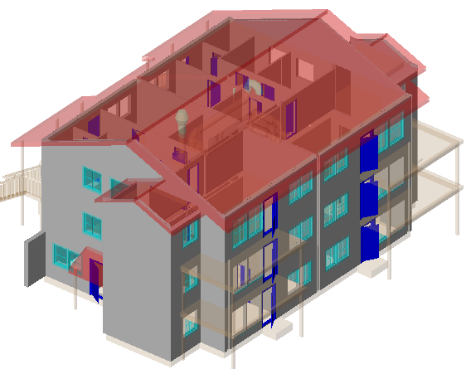
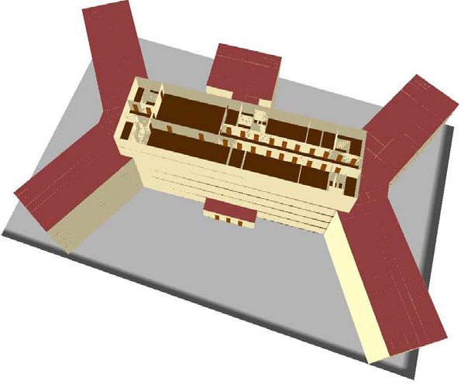
IndoorGML: Integrated Outdoor / Indoor location/navigation

Slide 18
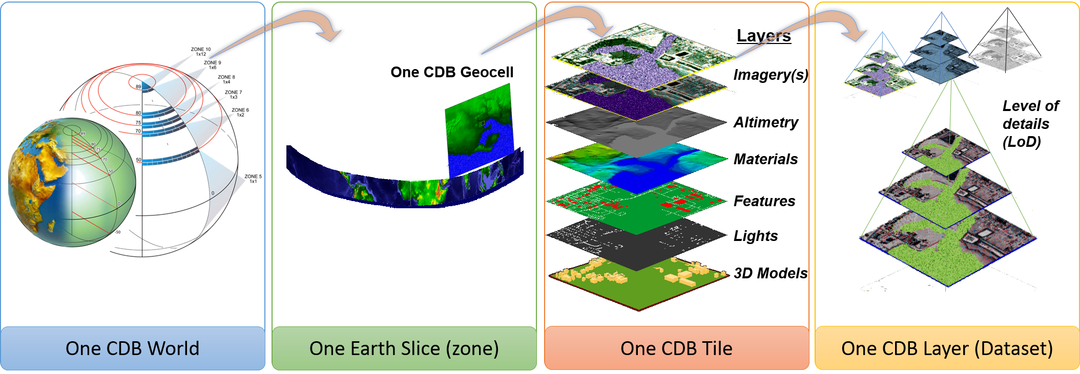
CDB
The CDB standard relies on three important means to organize the data:
Tiles – organization of data by location
Layers – organization of data by type
Levels of Detail (LOD) – organization of data by detail
Tile size and location are specified by CDB
The amount of data per LOD is specified by CDB
The data layers are specified by CDB (can be extended)

Slide 19
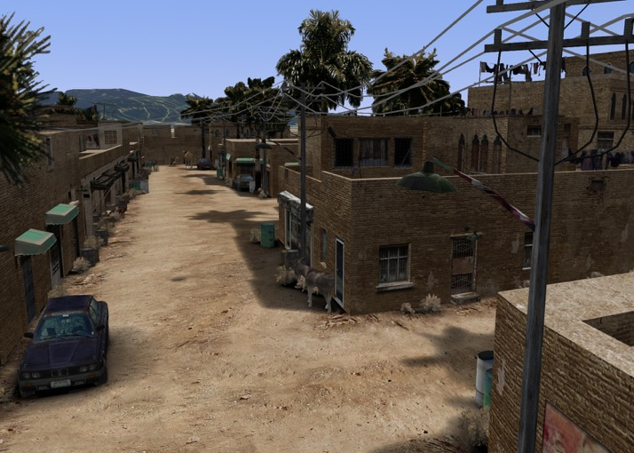
CDB in action
You have this…
…and you need to make this...
…or this
Courtesy CAE

Slide 20
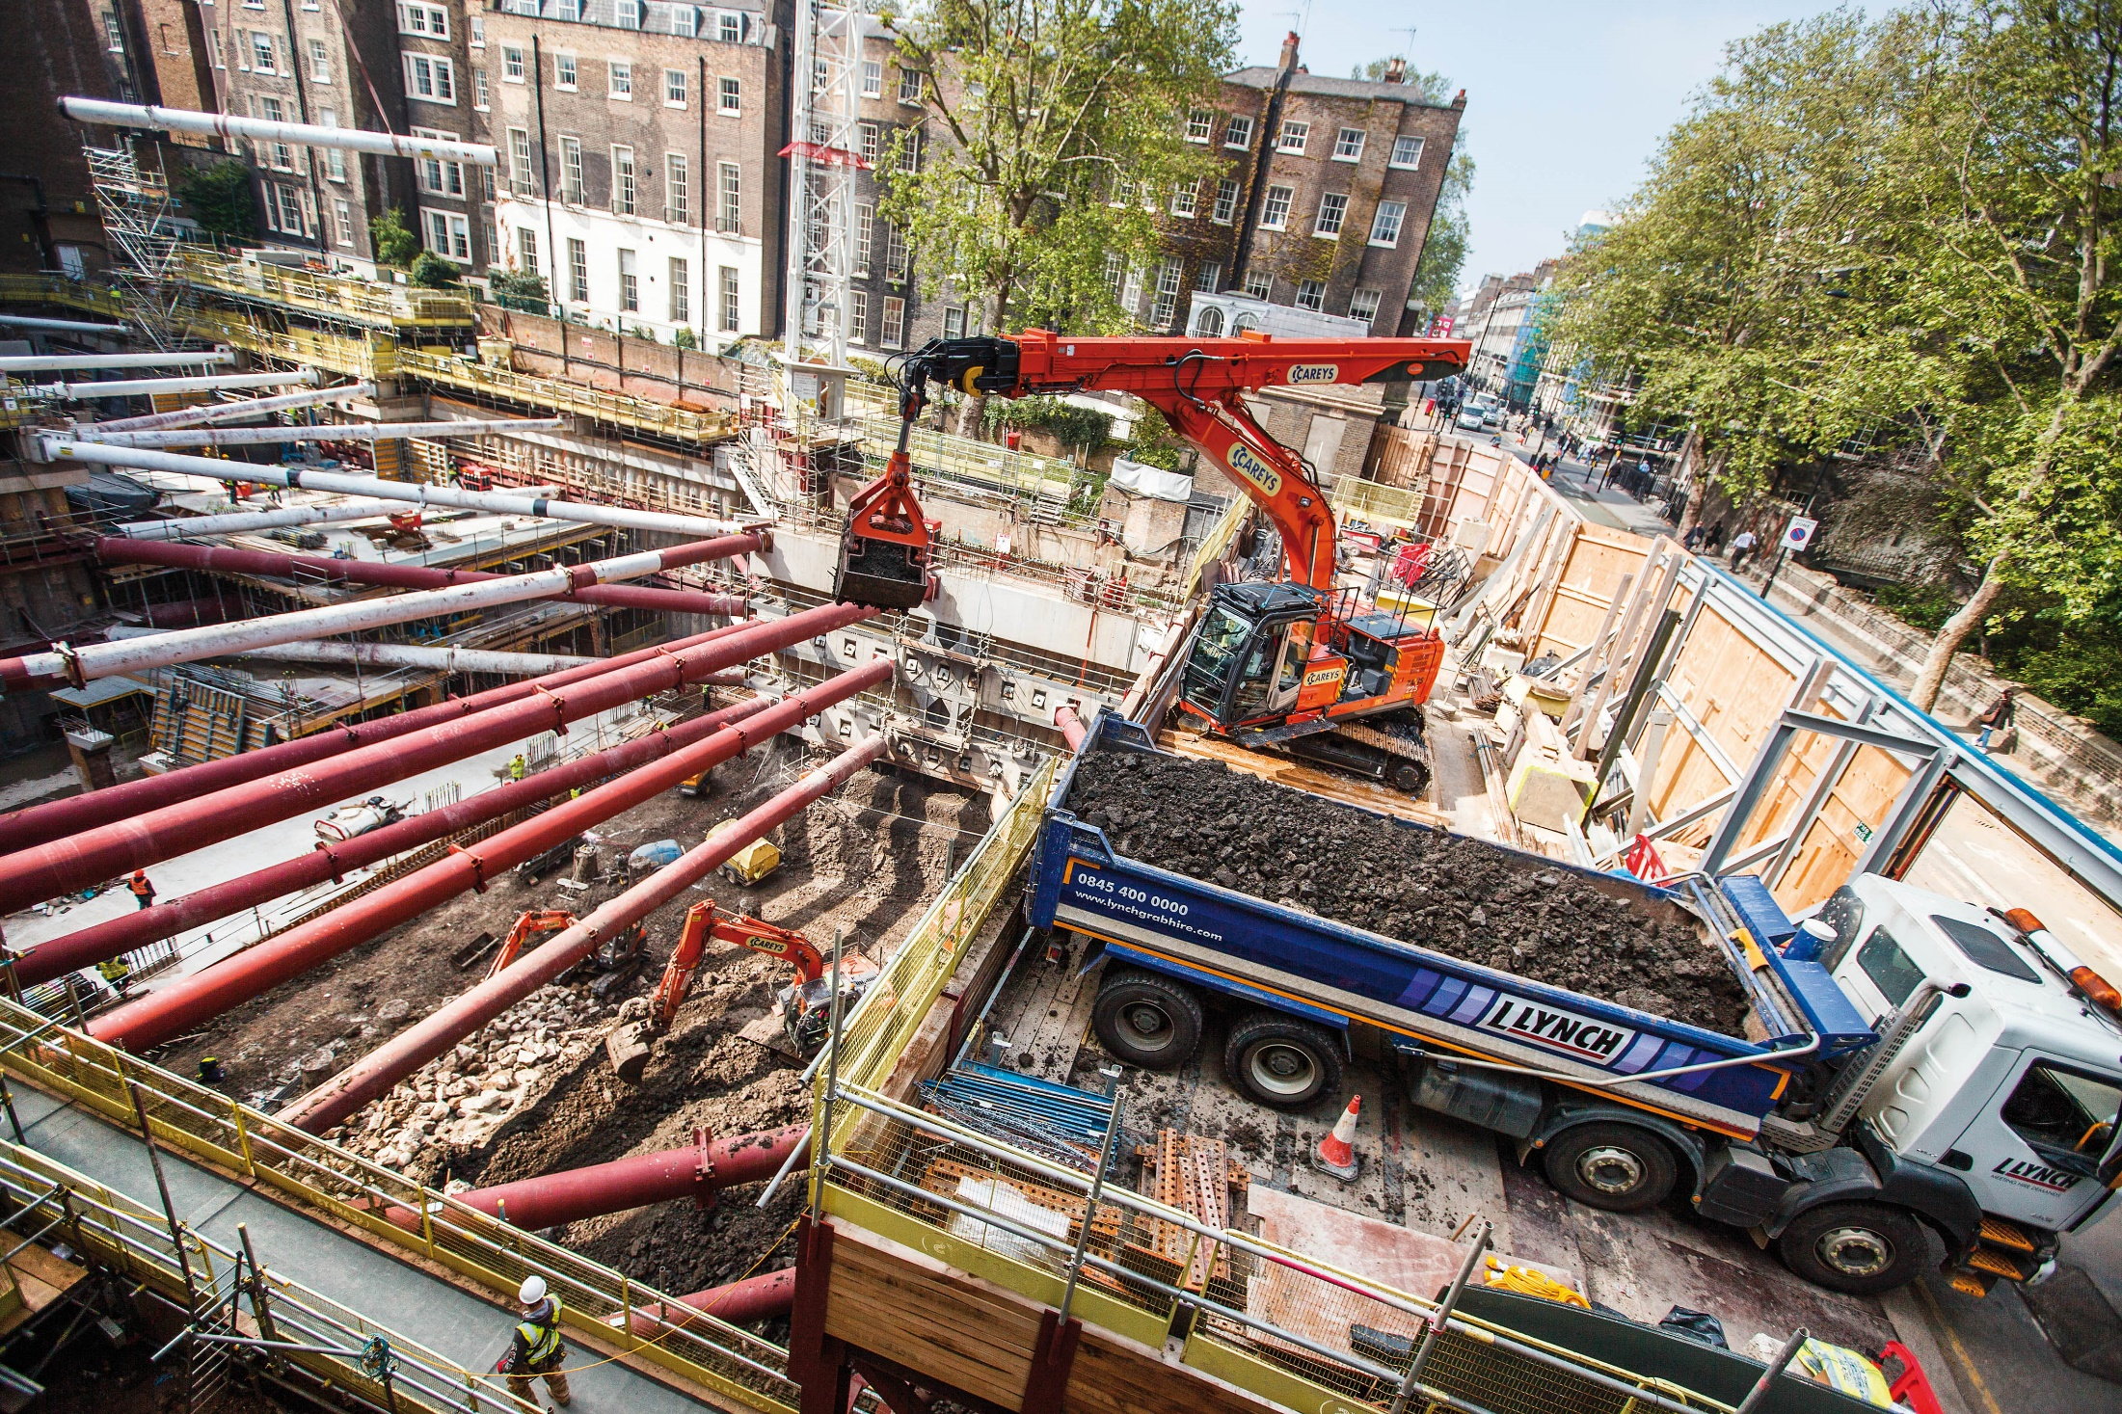
Map this…

Slide 21
… or get this - NYC Steam Explosion: July 2018

Slide 22
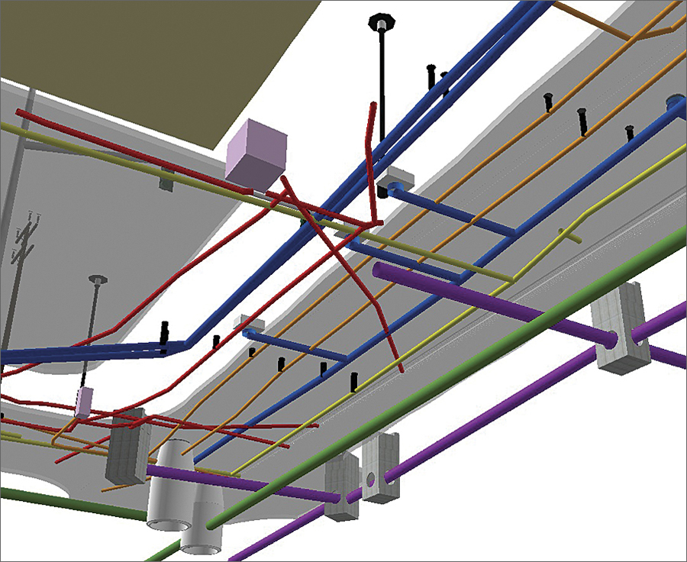
Model for Underground Data Definition and Integration (MUDDI)
Source: Esri

Slide 23
Doing something about it

Slide 24
Integrated Digital Build Environment and others
Integrated Digital Built Environment
Liaisons active between many organizations
Not focused just on data transformation
Heavy emphasis on semantic negotiation
Engaging national statistics bodies
OGC
IDBE
bSI
buildingSMART International
Joint Advisory Group
Cat A
Cat A
JAG Cat A
Cat A
Category A liaison
TC 211
JWG 14
TC 59 / SC 13
Geographic Information / Geomatics
Organization and digitization of information about buildings and civil engineering works, including building information modelling (BIM)

Slide 25
Understanding & Managing the Natural & Built Environment
Digital Engineering & Asset Management
Top-Down approach
Environment Modeling
Geospatial Modeling (OGC: GML schema / W3C: RDF triples)
data capture
regional analysis
scenario modelling
forecasting
provides context
design modelling
performance analysis
simulation
construction
returns as-built data
Bottom-Up approach
Building Information Modeling
(bSI: IFC schema, MVD & bSDD)
Built Asset Modeling
Planning, Design, Construction & Operation of Built Assets

Slide 27
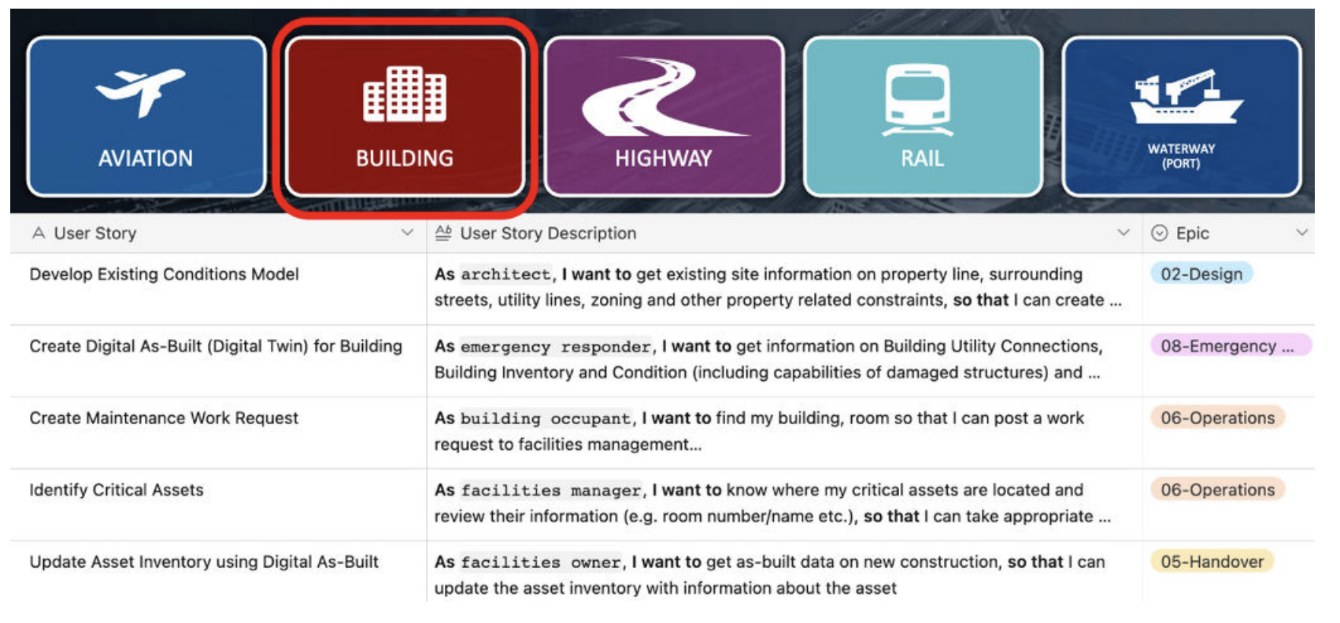

Slide 30
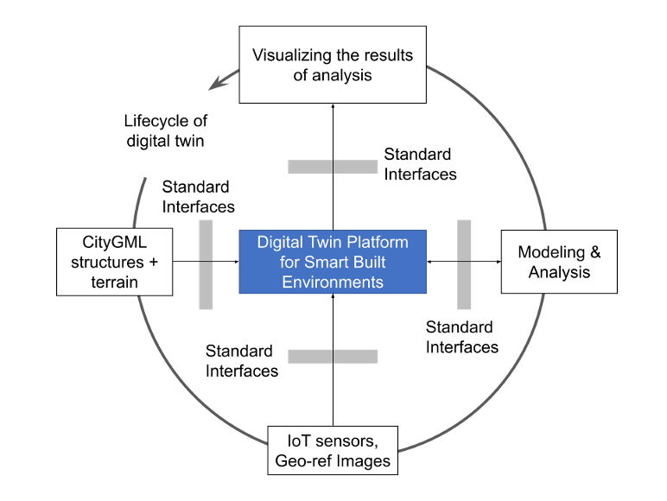

Slide 31
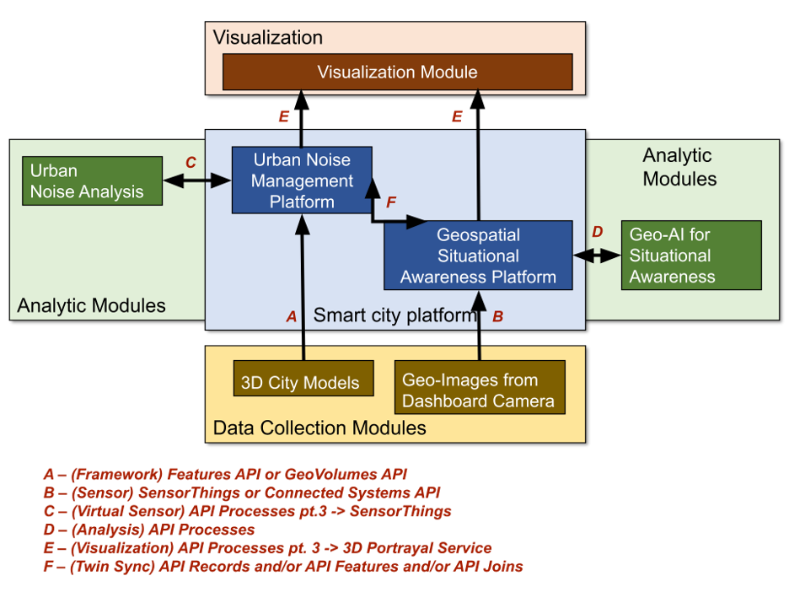

Slide 32
Thank You
Community
Scott Simmons
ssimmons@ogc.org

